Slide 1
Nonlinear Planning
Lecture Module 9

Slide 2
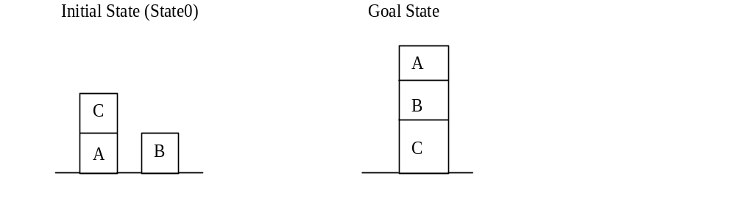
Difficult Problem
The Goal stack method is not efficient for difficult problems such as Sussman anomaly problem.
It fails to find good solution.
Let us consider the Sussman anomaly problem

Slide 3
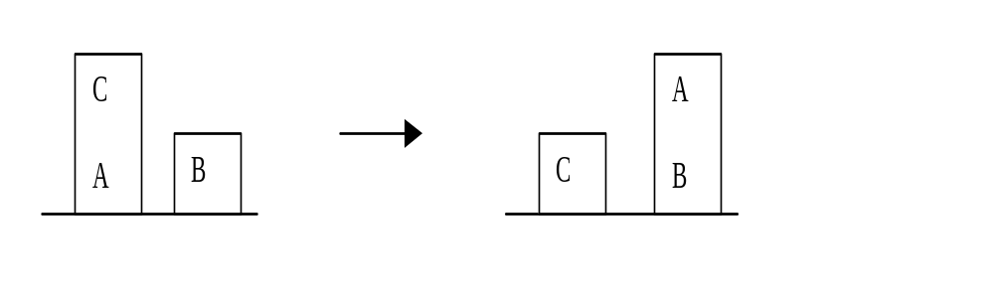
Cont…
Initial State: ON(C, A) Λ ONT(A) Λ ONT(B)
Goal State: ON(A, B) Λ ON(B, C)
Remove CL and AE predicates for the sake of simplicity.
To satisfy ON(A, B), following operators are applied
US(C, A) , PD(C), PU(A) and S(A, B)

Slide 4
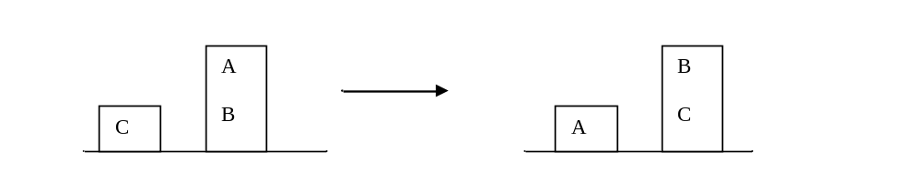
Cont…
State_1: ON(B, A) Λ ONT(C)
To satisfy ON(B, C), following operators are applied
US(A, B) , PD(A), PU(B) and S(B, C)
State_2: ON(B, C) Λ ONT(A)

Slide 5
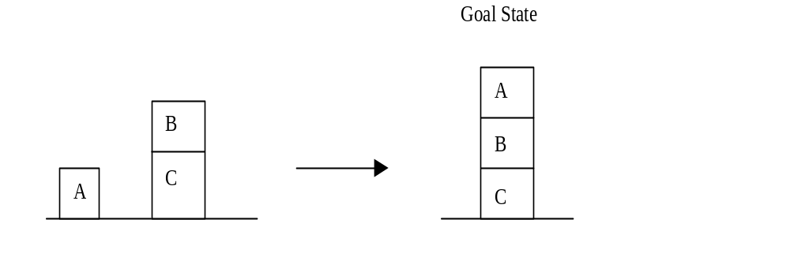
Cont…
Finally satisfy combined goal ON(A, B) Λ ON(B, C).
Combined goal fails as while satisfying ON(B, C), we have undone ON(A, B).
Difference in goal and current state is ON(A, B).
Operations required are PU(A) and S(A, B)

Slide 6
Final Solution
The complete plan for solution is as follows:
1. US(C, A)
2. PD (C)
3. PU(A)
4. S(A, B)
5. US(A, B)
6. PD(A)
7. PU(B)
8. S(B, C)
9. PU(A)
10. S(A, B)
Although this plan will achieve the desired goal, but it is not efficient.

Slide 7
Cont…
In order to get efficient plan, either repair this plan or use some other method.
Repairing is done by looking at places where operations are done and undone immediately, such as S(A, B) and US(A, B).
By removing them, we get
1. US(C, A)
2. PD (C)
3. PU(B)
4. S(B, C)
5. PU(A)
6. S(A, B)

Slide 8
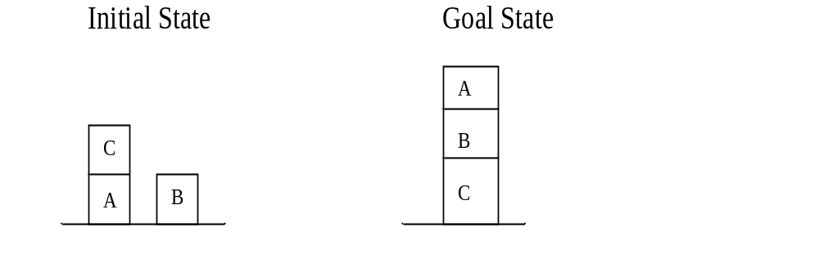
Nonlinear Planning with Goal Set
Generate a plan by doing some work on one goal, then some on another and then some more on the first one.
Such plans are called nonlinear plans as it is not composed of a linear sequence of complete sub plans.

Slide 9
Cont…
A good plan for the solution is the following.
  Begin work on goal ON (A,B) by clearing A thus putting C on the table.
  Achieve ON (B,C) by stacking B on C.
  Complete the goal ON (A,B) by stacking A on B.
Consider the collection of desired goals as a set.
Backward searching is used from the goal to the initial state with no operators being actually applied along the way.
Idea is to look first for the operator that will be applied last in final solution.
It assumes that all but one of the sub goals have already been satisfied.

Slide 10
Cont…
Consider a set of all sub-goals as start point of the search.
Find all the operators that satisfy the final sub goal
  Assume that all other sub goals are satisfied
In the example, consider the last sub goal to be proved as ON(A, B) or ON(B, C).
If ON(A, B) is the last sub goal, then
  all its preconditions and ON(B, C) are assumed to be true prior to this operation.
Whenever contradiction occurs in a goal set such as {HOLD(X), AE} or it contains false, then path is pruned.
  Many of the paths can be quickly be eliminated because of contradiction.

Slide 11
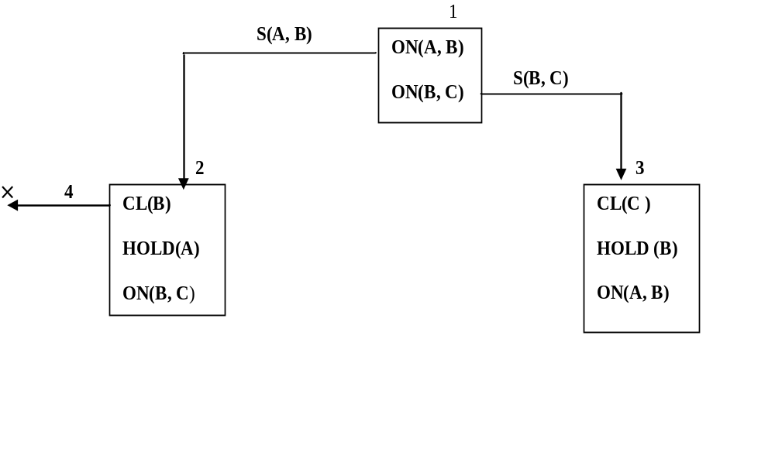
Cont…
CL(B) could be achieved by Unstacking something from B.
For this AE should be there which contradicts with HOLD and hence leads to contradiction in a set.

Slide 12
Cont..
When an operator is applied, it may cause the sub goals in a set no longer true.
So care is to be taken that non selected goals are not directly copied into new goal set
  but a process called regression is applied.
Regression can be thought of as the backward application of operators.
Each goal is regressed through an operator whereby, we are attempting to determine what must be true before the operator is performed.

Slide 13
Example of Regression
Reg(ON(A, B), S(C, A)) = ON(A, B)
Reg(CL(B), S(A, B)) = false
Reg(ON(A, B), PU(C)) = ON(A, B)
Reg(AE, PD(A)) = true
Reg(AE, S(X, Y)) = true
Reg(AE, PU(A)) = false
Reg(AE, US(A, B)) = false

Slide 14
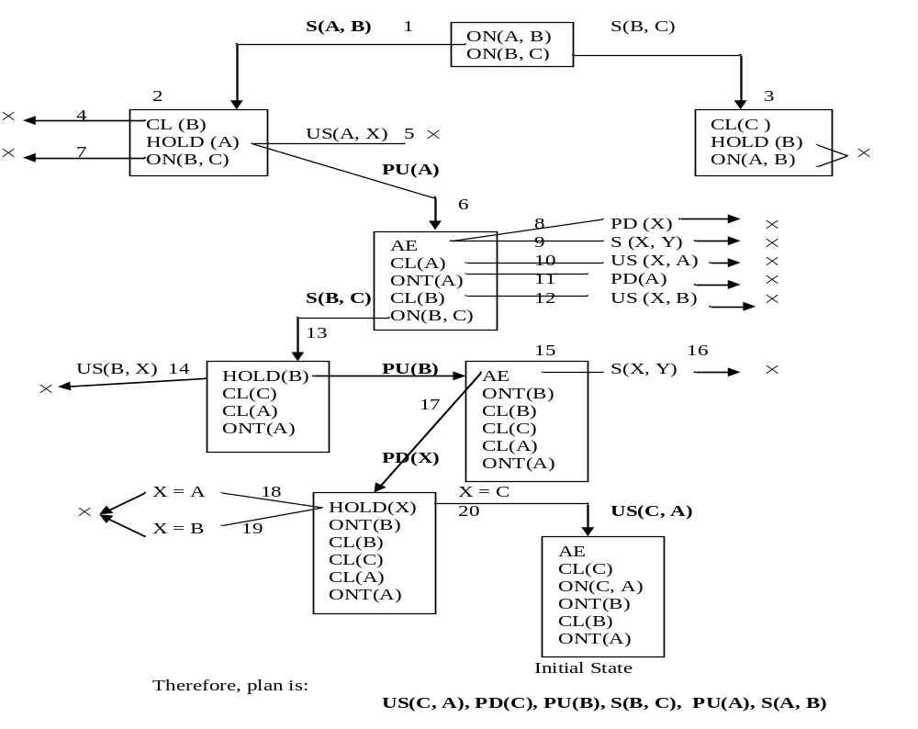

Slide 15
Means-Ends Analysis (MEA)
Means-Ends Analysis is another method based on nonlinearity.
It also centers around the detection of difference between current and goal states.
Once such a difference is isolated, an operator that can reduce the difference must be found.
The action is performed on the current state to produce a new state.
The process is recursively applied to this new state and the goal state
It is quite possible that chosen operator can not be applied to the current state immediately

Slide 16
Example
Assume S and G are start and goal states
S B_____C G
Start Operator Goal
By solving B to C, difference between S, B and C, G is reduced.
Order in which the differences are considered is critical.
Important that significant difference be reduced before less significant otherwise great deal of effort may be wasted.
This method is not adequate for solving complex problems, since working on one difference may interfere with the plan of reducing another.

Slide 17
Cont…
Reduce the difference between S & B and similarly between C & G.
MEA also relies on a set of rules just like in other problem solving techniques.
These rules are usually not represented with complete state description on each side.
Instead they are represented as
  left side that describes preconditions and
  right side that describes those aspects of the problem state that will be changed by application of the rule.

Slide 18
Example: House hold Robot
Find a sequence of actions robot performs
  Move desk with two things on it from one location S to another G.
Operators are: PUSH, CARRY, WALK, PickUp, PutDown and PLACE.
Main difference :
  Change of location of desk from initial position to goal position
Here objects on top must also be moved.
Data structure called ‘Difference Table’ indexes the rules by the differences that they can be used to reduce.

Slide 19
Cont…
Operator | Pre-conditions | Result
PUSH(obj, loc) | At(robot, obj) Λ Large(obj) Λ Clear(obj) Λ AE | At(obj, loc) Λ At(robot, loc)
CARRY(obj, loc) | At(robot, obj) Λ Small(obj) | At(obj, loc) Λ At(robot, loc)
WALK(loc) | None | At(robot, loc)
PU(obj) | At(robot, obj) | Hold(obj)
PD(obj) | Hold(obj) | ~Hold(obj)
PLACE(Obj1, obj2) | At(robot, obj2) Λ Hold(obj1) | On(obj1, obj2)

Slide 20
Difference Table
 | PUSH | CARRY | WALK | PU | PD | PLACE
Move object | * | *
Move robot |  |  | *
Clear object |  |  |  | *
Get obj1 on obj2 |  |  |  |  |  | *
Get arm empty |  |  |  |  | * | *
Hold object |  |  |  | *

Slide 21
Cont…
Move Desk with two small bags on it from S to G.
To reduce this difference apply either CARRY or PUSH operator.
If CARRY is chosen first, then its preconditions be met.
This results in two more differences
  At(robot, desk) and Small(desk).
Here desk is not small, so CARRY can not be applied.
So choose PUSH which has four preconditions viz.,
  At(robot, desk) Λ Large(desk) Λ Clear(desk) Λ AE
Main important differences are only two i.e., At(robot, desk) Λ Clear(desk) and other two are common at start and goal positions.
S B________C G
Start PUSH Goal

Slide 22
Cont..
The differences between S and B can be reduced.
At(robot, desk) by WALK(desk_loc)
Clear(desk) by clearing two items on the desk.
  Clearing top can be done by two uses of PU operators.
  After one Pick up, an attempt to pickup second item results in another difference i.e., arm of robot be empty.
  This difference is reduced by PD operator.
So, we get sequence of following operators:
S(Start)_____________________________________B__________C
WALK(desk_loc)->PU(obj1)->PD(obj1)->PU(obj2)->PD(obj2) PUSH
Once PUSH is performed, problem state is close to goal state.
Now objects must be placed on the top of desk.

Slide 23
Cont...
The difference between C and G is achieved by PLACE operator.
S(Start)______________________________B_____ C E________G(Goal)
WALK->PU(obj1)->PD(obj1)->PU(obj2)->PD(obj2) -> PUSH PLACE
The final difference between C & E can be reduced by using WALK to get robot back to objects, followed by PU and CARRY operators. Final Plan is as follows:
→ WALK (start_desk_loc) → PU(obj1) → PD(obj1) → PU(obj2)→
WALK(start_desk_loc) ← PUSH(desk, goal_loc) ← PD(obj2)
→ PU(obj1) → CARRY(obj1,goal_loc) → PLACE(obj1,desk) →
PLACE(obj2,desk) ← CARRY(obj2, goal_loc) ← PU(obj2) ← WALK(start)

